Slide 1
.
TECHNOCRATE’S
BHASKAR C
BHARATH R
BHANU PRAKASH P
BALAJI G K
B M DEVIKA VARMA
ANUSHREE K R

Slide 2
STREET LIGHT PROBLEM
SDG GOAL :- 11: MAKE CITIES & HUMAN SETTLEMENTS INCLUSIVE, SAFE AND SUSTAINABLE

Slide 3
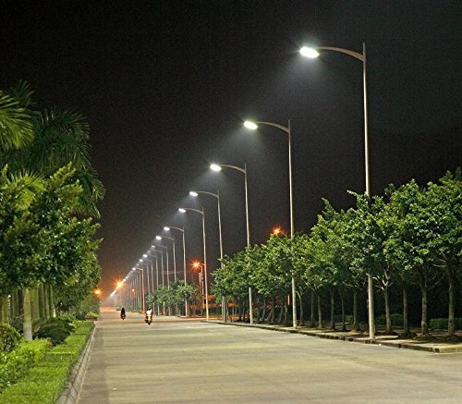
IMPORTANCES OF STREET LIGHT
Road lighting provides
visual condition for safe,
quick and comfortable,
movement of road users
under night conditions.

Slide 4
INTRODUCTION:-
MAINLY STREET LIGHT PROBLEMS ARE CAUSED DUE TO
High consumption of energy.
Difficulties related to the maintanance of the system.
Electric bill of the street lighting system.

Slide 5
PROBLEM IDENTIFICATION
WHO:- Narendra swamy
WHAT :- Unsafe to walk
without street light
WHERE :- Near Chagalatti

Slide 6
PRIMARY INFORMATION
They tell that even being street light pole in road ,but it is not yet installed properly.
Even being a street light the light quality is poor and also it is unsafe for women and girls.
Mainly the intension of locality about street light to have a safety at night firstly.
Other’s have a intension that even being street light they are not ON at the time.
Also to decrease the accident rate

Slide 7
PRIMARY INFORMATION
INFORMATION COLLECTED NEAR BUDIGERE CROSS
Street light has been a problem for the people living in Budigere Cross near Prerana international school, since a long time. The people are more concerned of our safety as sometimes they are late from work due to night shift.
Without street light it feels unsafe to walk even in footpath
Whenever a festival or an event is hosted here, the road is adorned with lights and decorations. The street plunges into darkness after the event is over,” a local resident.

Slide 8
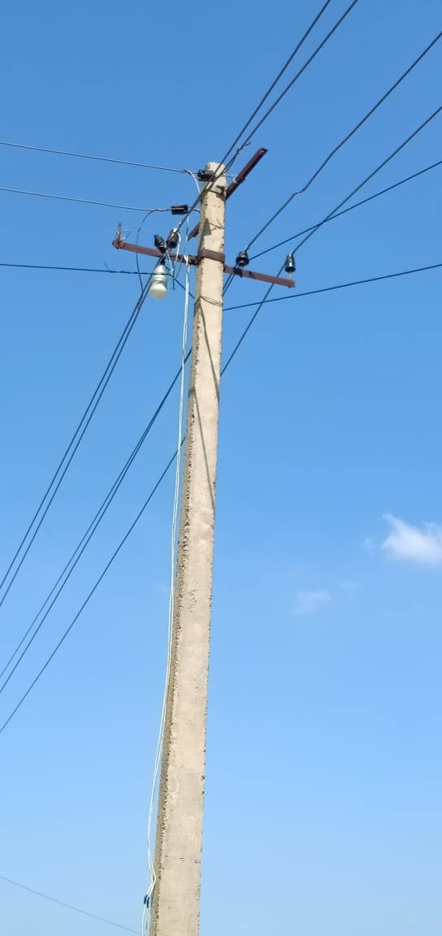
PROBLEM FACED BY THE PEOPLE
There is no proper street light in the area,
the people of the area
(CHAGALATTI) they
themselves have setup
a light of the cable
tower ,even after
knowing it is very
dangerous

Slide 9
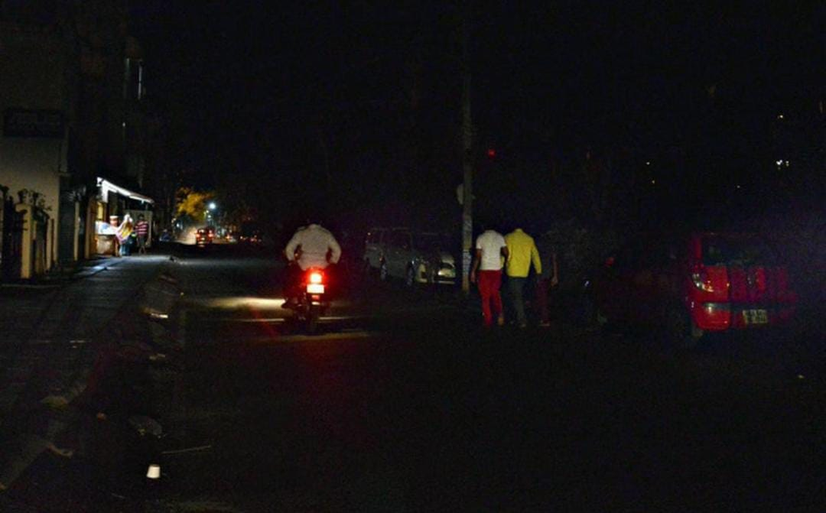
SECONDARY INFORMATION
Without street lights, it is scary and dangerous to walk at night

Slide 10
SECONDARY INFORMATION(NEWSPAPAER)
Woman in Koramangala experienced nightmarish Noticing her walking alone on a dimly- lit road around 8.30 p.m., a cab driver attempted to rape her.

Slide 11
SECONDARY RESEARCH
In Bangalore, “The lights along the service road on the back of the IT hub have a been disfunctional for a while, since more facilities are situated along the road lack of lights aare causing misery. Most times the road is deserted and we feel unsafe”. Said Reshmi chandran

Slide 12
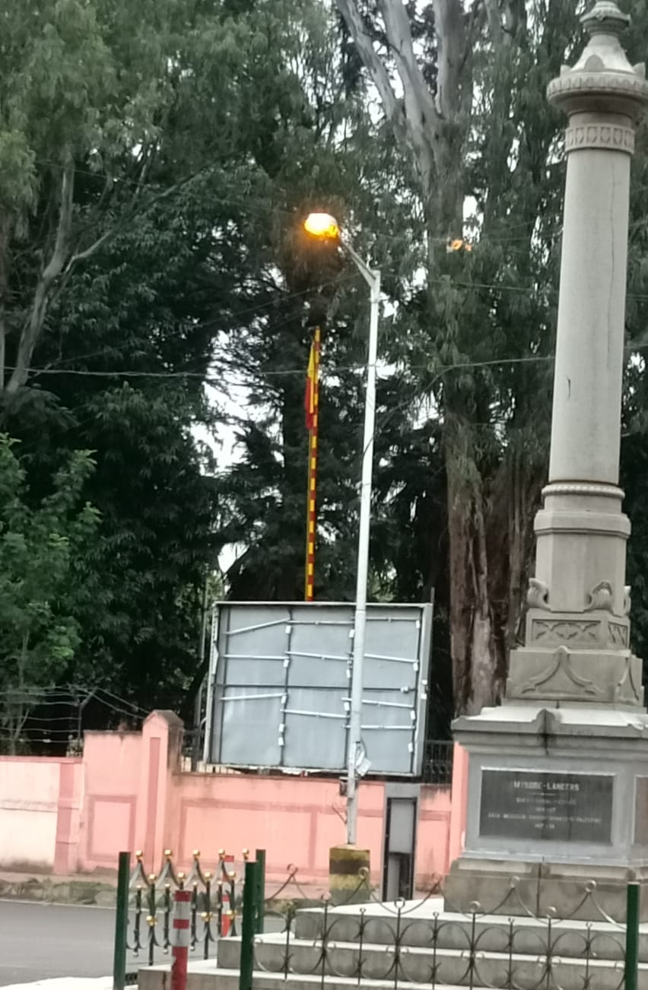
STREET LIGHTS TURN ON DURING DAYTIME
There is lot of waste
of electricity during daytime,
Street light in there area are
ON in day time for since
almost a week , This is the
case in many other parts
of the city too.

Slide 13
Even being street light ,they do not turn on the time
There is no proper wire connection between the street light poles
There is no person appointed to control the street light , i.e to turn ON or OFF the street light street
Even being street light pole ,the bulb or LED is not yet installed

Slide 14
STREET LIGHT IS TURN ON DURING DAY TIME
Lot of electricity is wasted.
  Also we can install automatic street light, which can turn on &turn off through the sensor.

Slide 15
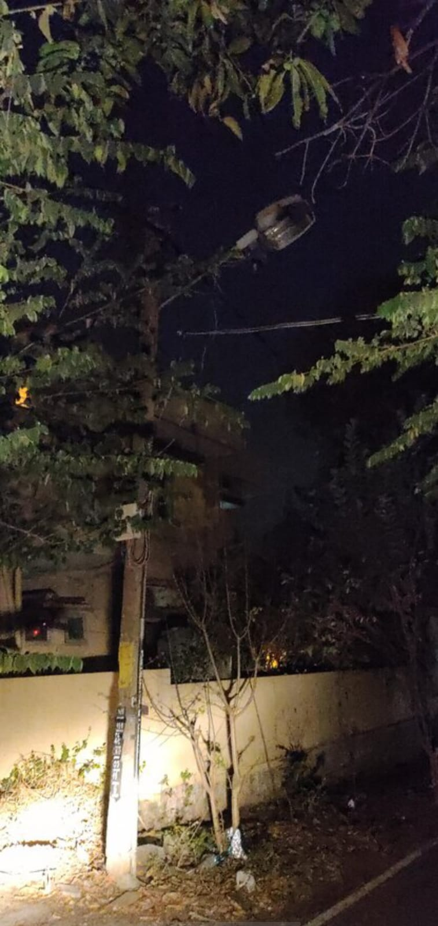

Slide 16
PUBLIC RESPONSE TO TURN ON & OFF STREET LIGHT
The person who control the street light should be appointed one of them in the locality.
If any problem in the street light ,it should be immediately informed the bescom office to solve the issue
And to make sure street light is OFF whenever it is not required.
Other’s with the opinion of installing the automatic street light which can turn ON or OFF when it is required

Slide 17
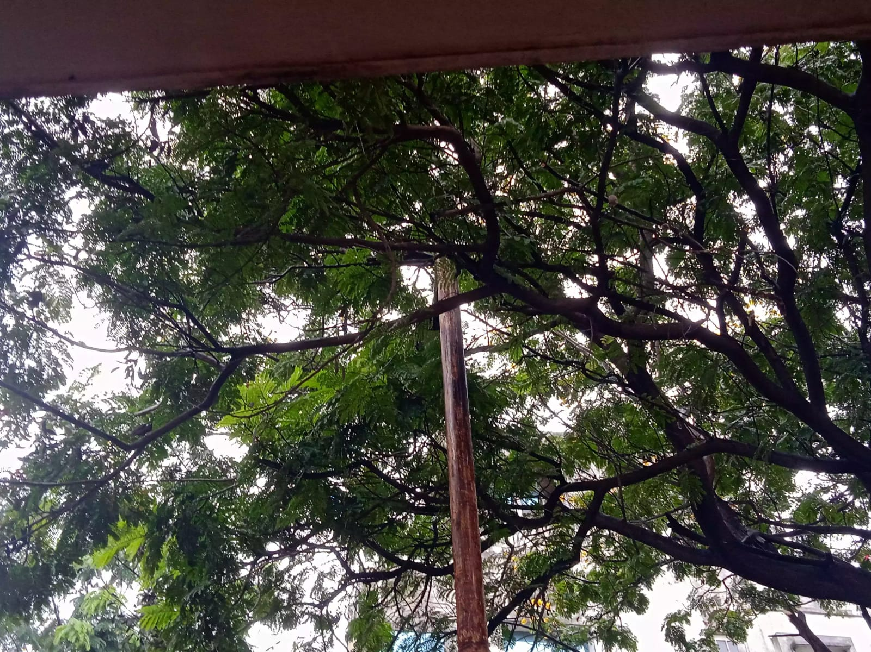
Even being street
light, the trees are
covered
There is dim light
present during
night.

Slide 18
HINDU’S NEWS UPDATES
The Bengaluru’s street light is all set for the replacement to smart intelligent streetlight
It will also setup a centralized control & monitoring system from where street light can be managed
This is develop to reduce the energy wastage and to track all issue related to the streetlight from the control room

Slide 19
GRAPH OF RECENT STREET LIGHT IN THE YEAR 2022

Slide 20
STREET LIGHT PROBLEM
Women/ Girls
Harresment
Afraid of
Darkness
Accident rates
Residence
Near Chagalatti
Night shift- Dog chasing
Even being street light tree are covered
Lots of electricity is wasted

Slide 21
THE 5 WHY’S
*Why the residency of Chagalatti people are facing the problem of street light ?
* BBMP did not install street light
* There is no much of people living in a locality
*Because Chagalatti is a rural place
*As it is away from the city

Slide 22
HOW MIGHT WE
*How might we install cost-effective street light in Chagalatti
*How might we install street lamps instead of street light
* HOW MIGHT WE ENSURE WOMEN’S/GIRLS WALK SAFELY WITH STREET LIGHT IN CHAGALATTI
*How might we illuminate the road with street light in more efficient way ,so that we can walk safely .
*How might we appoint a person to turn ON or OFF the street light

Slide 23
FINAL PROBLEM STATEMENT
Women / girls feel unsafe to walk alone during night from Chagalatti to CMR UNIVERSITY

Slide 24
FINAL HOW MIGHT WE
HOW MIGHT WE ENSURE WOMEN’S/GIRLS WALK SAFELY WITH STREET LIGHT IN CHAGALATTI

Slide 25
BRAINSTORM’S
What if we can install cost effective small lamps ,LED’s, solar lights instead of street light.
What if we could install cost effective LED light’s
What if we could install solar light
What if we can appoint 2-3 NCC boys to pickup from bus stand..

Slide 26
CLUSTER OF IDEA
To install automatic : It is not feasible
street light It is Desirable
It is viable
To install cost effective : It is Feasible
LED light It is Desirable
It is Viable
To make sure that the : It is feasible NCC boys to pick them It is desirable
from bus stand It is viable

Slide 27
To appoint a person : It is feasible
to look after the area It is desirable
during night time It is viable
To implement a street : It is not feasible
lamps beside the road It is viable
It is desirable

Slide 28
CASE STUDY
Existing solutions, why it doesn’t work or fails to solve the problem
The main reason for failing to solve the problem of street light are
Loose connections
Voltage fluctuation
Replacement

Slide 29
Being a street light is very useful,but investment to install it is high
In some area ,automatic street light are installed ,but due to the light is not wired (theft issue) and much expensive
To rechange the batteries is also very difficult
To install solar light investment is high when compared to normal street light
The consumer who buys the street light in huge amount is been tricked by choosing fake product

Slide 30
The measure’s women/girl can feel safe while travelling alone (even being street light)
Keep a pepper spray in bag
Keep 100 on speed dial
Not to wear expensive items i.e, gold chain or earring while travelling
To appoint a watchman to pick up and drop to the home safely
Women can carry whistle
To send live location for trusted person(Family,Friends)

Slide 31
BUILD YOUR IDEA
Name : RIGHT TO WOMEN SAFETY
Tag line : STAND UP FOR WOMEN/GIRL
PROTECTION
Value to user : TO FEEL THEMSELVES SECURE
Value to org : RESPECT IN THE SOCIETY
Impact on SDG’s : DEVELOPMENT IN THE SOCIETY
IN SAFETY

Slide 32
BUILD YOUR IDEA
ASSUMPTIONS:
Assuming we as a government – to install CCTV camera to protect women
Assuming we are organisation – provide pepper spray ,chilli spray(man made), small knife and teach them how to use emergency button on phone….

Slide 33
 | TRENDS | SUCCESS | FAILURE
INSIGHTS | TO INSTALL CCTV CAMERA IN THE LOCALITY AS WOMEN CAN FEEL SECURE | FEEL SAFE , AVOID AFRAID OF THEFT | WHEN THERE IS NO POWER SUPPLY IN AREA DURING NIGHT
RESPONSE | INCASE IN TROUBLE AS SHE CAN DOUBLE CLICK THE POWER BUTTON OF MOBILE | AS LOCATION WILL BE DIRECTLY SEND THE NEAR BY POLICE STATION AND CAN HAVE A ENQUIRY | BY CHANCE OF MOBILE BATTERY IS LOW OR DRAINED
MARKET RESEARCH

Slide 34
VALUE PROPOSITION MAPPING
 | STAKEHOLDERS | SOLUTIONS
NEEDS | To make sure the women/girl feel secure during night even after being street light | Atleast knowing a self-defence to protect herself OR being aware of the surroundings
WANTS | A proper facilities in the road | Security measures like CCTV camera ,provide night time transportation

Slide 35
FINAL SOLUTION
KEEP 100 ON SPEED DIAL
PUSH THE POWER BUTTON TWICE
IT IS GOING TO CALL EMERGENCY SERVICES
IT PLAYS LOUD SOS SOUND
SEND’S LIVE LOCATION TO NEAREST POLICE STATION
IT SWITCH ON SOS FLASH LIGHT
[CISF] CENTRAL INDUSTRIAL SECURITY PERMITTED TO CARRY KNIFE UPTO 4 INCHES OF LENGTH FOR SELF PROTECTION……

Slide 36

TEST

Slide 37
GROUP OF 2-3 NCC BOYS OF CMR CAN COME TO PICKUPA GIRL FROM BUS STAND
THIS WE CAN PROTOTYPE THROUGH DIGITAL APP
APP FOR NCC STUDENTS AND HOSTEL GIRLS

Slide 38
HOW WILL YOU TAKE YOUR PROJECT TO THE NEXT LEVEL?
WE WOULD LIKE TO CREATE A WOMEN/GIRL SAFETY APP OF CMRU GIRLS
THROUGH THIS APP GIRLS CAN ASK THE NCC STUDENTS TO COME AND PICK UP FROM THE CHAGALATTI BUS STAND AT NIGHT PEAK TIME
THIS APP IS COMPLETELY TRUSTED APP AND ALSO IT HAVE AN ACCESS TO COLLEGE ALSO
AS NCC STUDENTS HAVE BEEN SIGNED ON BOND PAPER TO HELP THE GIRLS AND MAKE HER TO FEEL SAFE

Slide 39
THISAPP IS ONLY ACCESSABLE FOR NCC STUDENTS AND CMRU GIRLS
GIRL SHOULD LOGIN THROUGH THE APP & INFORM THE NCC STUDENT TO PICK HER BEFORE REACHING THE BUS STAND
SHE HAS A ACCESS FOR ONLY 4-5 TIMES AS IT SHOULD NOT BE TAKEN AS AN ADVANTAGE
INCASE OF EMERGENCE ,SHE CAN CALL THE NCC STUDENTS TO PICK HER
ONCE’S SHE ENTER THE HOSTEL , SHE HAS TO REPORT THE MOVEMENT IN THE PORTAL.

Slide 40
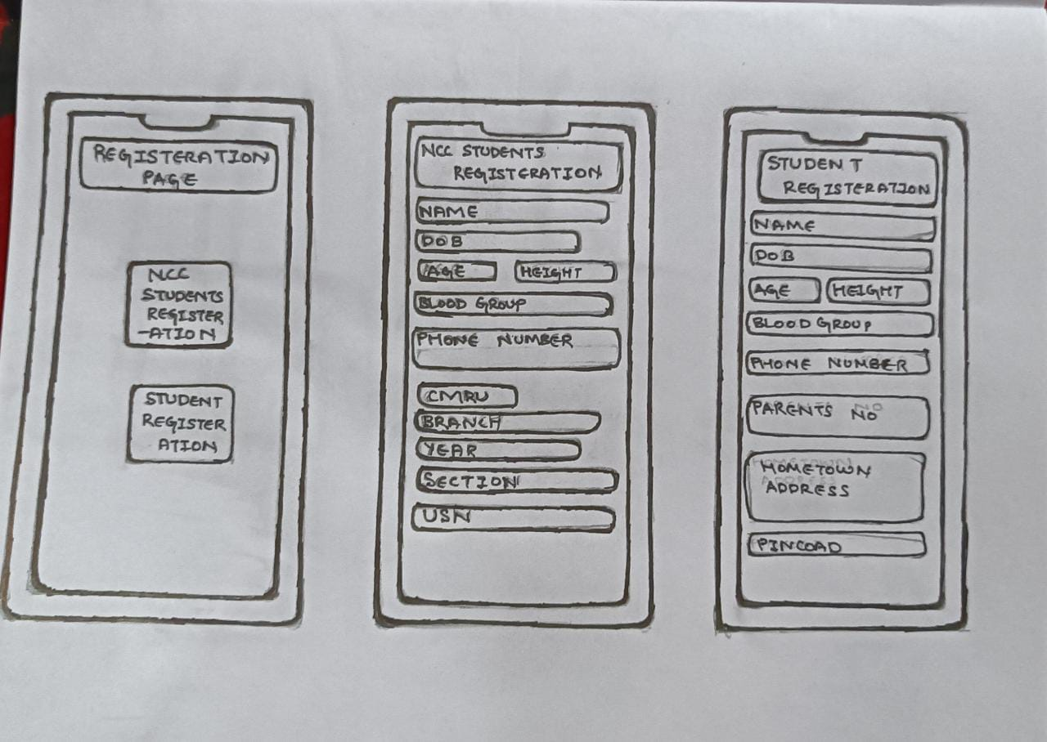
APPLICATION INTERFACE

Slide 41
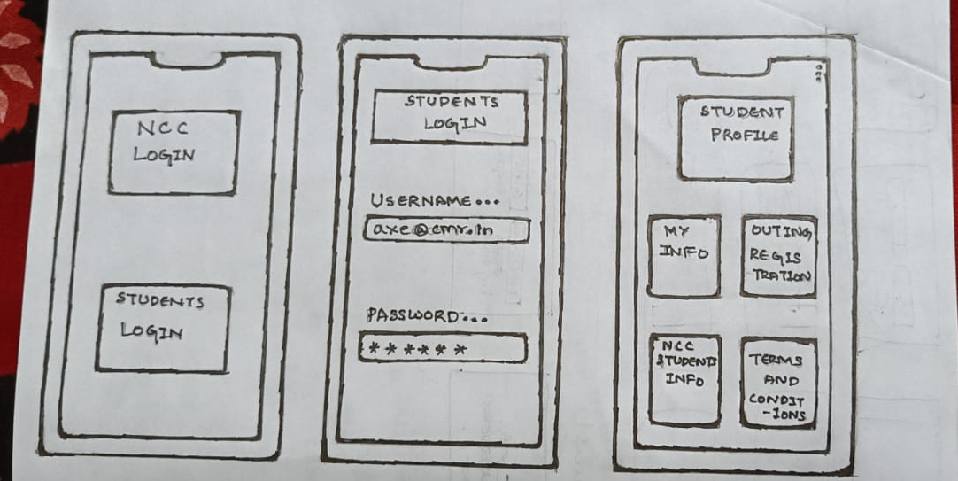

Slide 42
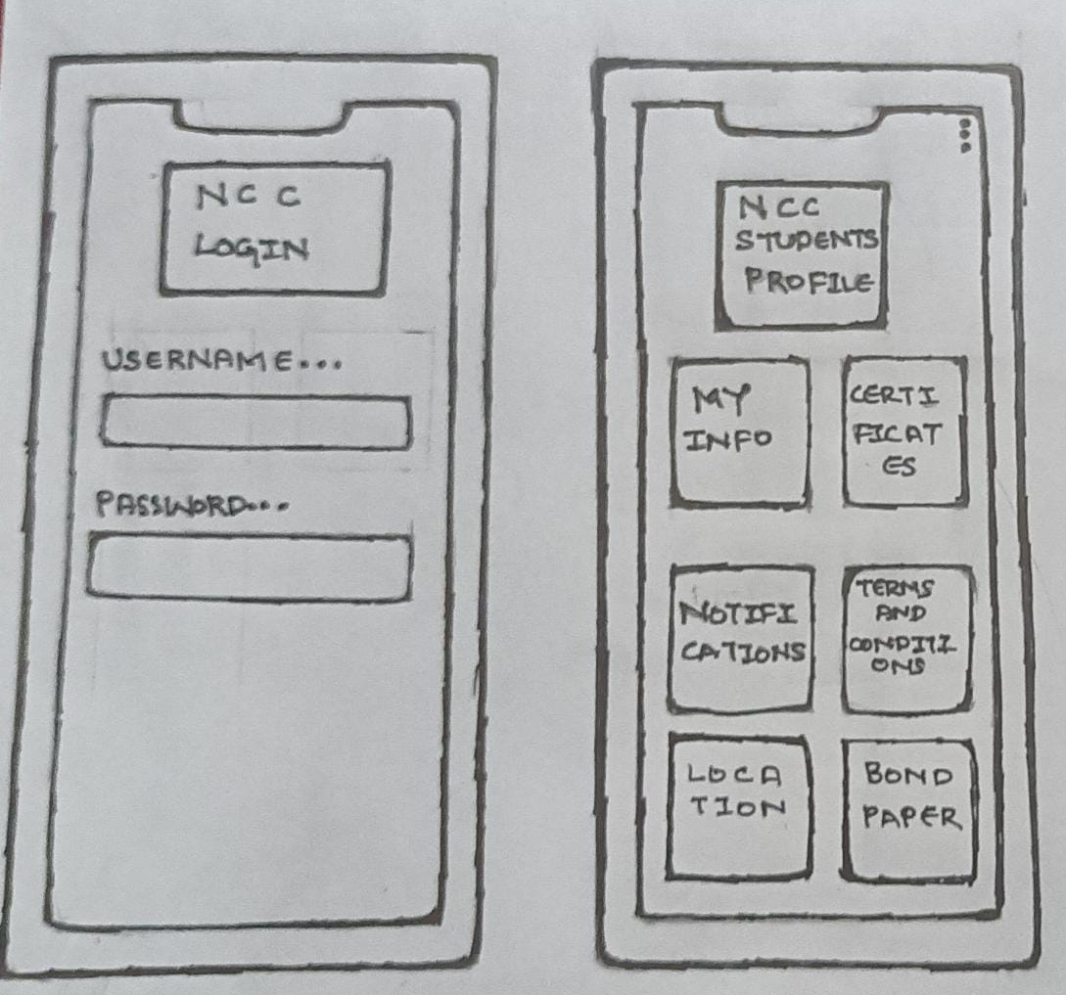

Slide 43
WHAT HAVE BEEN YOUR TOP LEARNINGS FROM DESIGN THINKING
It helps individuals to develop their organisation’s products, services, processes and strategies with minimal issues.
By applying the Design Thinking approach in an organisation, individuals can collect customer feedback that can help them redesign their products or services using innovative solutions.
It helps us to build on ideas and helps us to make different ideas from different teammates as all are having different range of ideas`````````````````````````````````````````````````````

Slide 44
WORK LOG
STUDENT NAME | WORKD DONE
BHASKAR.C | EMPATHIZE, DEFINE , IDEATE & PPT
BHARATH.R | EMPATHIZE, DEFINE & IDEATE
BHANU PRAKASH P | EMPATHIZE, DEFINE & TEST
BALAJI GK | EMPATHIZE & DEFINE
B M DEVIKA VARMA | EMPATHIZE, DEFINE, PROTOTYPE &PPT
ANUSHREE KP | BRAINSTORM IDEA AND MARKET RESEARCH

Slide 45
THANK YOU

